Slide 1
SAI PAKISTAN By Tafakhar Ali Asdi Director General Audit
AUDIT OF PUBLIC PROCUREMENT

Slide 2
Sequence of Presentation
Introducing SAI Pakistan
Vision and mission
Core Values
Functions
Defining
Public Procurement
Audit of Public Procurement
Public Procurement and its Audit in SAI Pakistan
PPRA Rules
Major Audit Findings
TOR of WGPA
Goal One and Suggestions
Goal Two and Suggestions

Slide 3
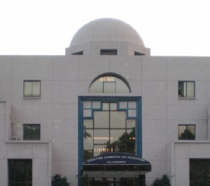
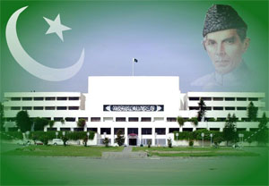
Introducing SAI Pakistan
Supporting Parliamentary Oversight of Public Resources
A Model Supreme Audit Institution promoting accountability, transparency and good governance in the management and use of public resources

Slide 4
Introducing SAI Pakistan Vision and Mission
VISION
A model Supreme Audit Institution (SAI) adding value to national resources
MISSION
Serving the nation by promoting accountability,
Transparency and good governance in the
management and use of public resources

Slide 5
Introducing SAI Pakistan Core Values
Integrity
Quality
Partnership
Our Way of Life
Our way of Doing Business
Our Way of Interaction
Continued

Slide 6
Introducing SAI Pakistan Legal Framework
Auditor General of Pakistan performs his functions under Article 169 & 170(2) of the constitution of Islamic Republic of Pakistan.
Only Constitutional body that supports Parliamentary oversight over management and utilization of Public Funds
Audit reports are the basis on which Parliament holds the executive(s) accountable
Timely Review of Audit Report(s) by PAC enhances effectiveness of accountability process

Slide 7
Introducing SAI Pakistan Functions
SAI Pakistan performs Functions of :
Certification Audit of accounts of the Federation, Provinces and Districts
Compliance with Authority Audit of all expenditure from the Consolidated Fund and the Public Account
Performance Audit for evaluation of economy, efficiency and effectiveness in resources’ utilization vis-à-vis targeted output
Special Audits Special studies and analysis on the request of Federal, Provincial and District governments
Audit of receipts of Federation, Provinces and Districts
Audit of companies and corporations in accordance with the provisions of their respective laws

Slide 8
Conceptual Approach: Key Actors and their Relationships
PUBLIC FINANCIAL ACCOUNTABILITY
Parliament
Accountability
Relationship
Reports
Public
AGP/ SAI Pakistan
Executive
Examines

Slide 9
Public Procurement
Public Procurement, is the procurement of goods, services or works on behalf of a public authority, involving public funds, such as a government agency

Slide 10
Procurement Process
Stage 1 :Annual Procurement Planning
Stage 2: Requisition / Requirements
Stage 3: Identify Suppliers
Stage 4: Bidding Process
Stage 5: Evaluating Offers
Stage 6: Awarding Contract
Stage 7: Administering Contract
Notes:
The seven stage procurement process is based on Government of Pakistan’s PPRA Rules (Public Procurement Regulatory Authority). Provinces have their own PPRAs with mostly similar rules.

Slide 11
Public Procurement Audit
Audit of public procurement is done in two stages:
Audit of Procurement process
Audit of contracts resulting from procurement
process

Slide 12
Public Procurement & Audit as defined by INTOSAI
Public procurement is procurement of
Goods,
works or
Service
for the satisfaction of public needs which is made by procurement customer/procurement agency authorized in accordance with national laws on public procurement.
The Public Procurement Audit is SAI`s audit activity which is dealing with Public Procurement processes and implementation of public procurement Contracts
Source: Public Procurement Audit Practical Guide developed by INTOSAI Task Force

Slide 13
Public Procurement AUDIT Significance
Auditing public procurement enforces accountability that ensures transparency which is essential for the citizens ‘confidence in the optimum utilization of Public money as per canons of financial propriety
Public Procurement audit provides
valuable tools to auditors for evaluating public procurement processes and issues,
helpful analysis for researchers
Value for Public Money
considerable value to the audit capabilities and procurement activities.

Slide 14
Audit of Public Procurement in Pakistan

Slide 15
Legal Framework of Public Procurement
Public Procurement Rules 2004
Public Procurement Regulations, 2008
Public Procurement Regulations, 2009
Procurement of Consultancy Services Regulations, 2010
Public Procurement Regulations, 2011
PPRA Instructions
General Financial Rules

Slide 16
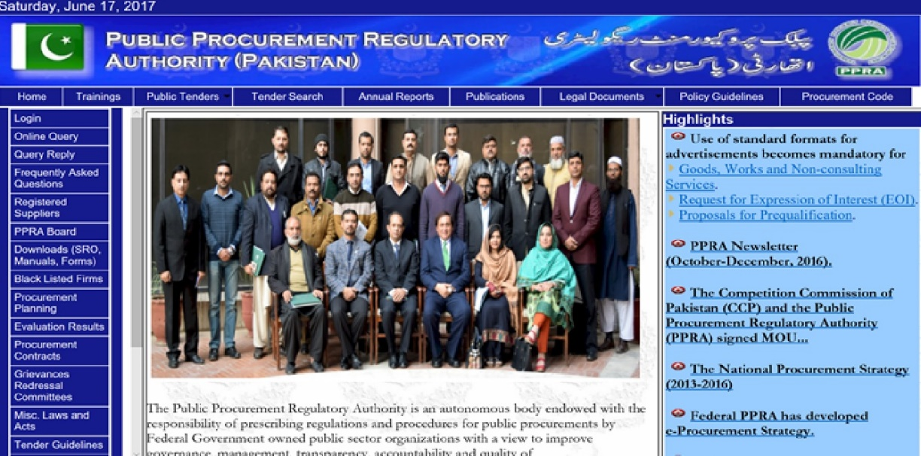
Public Procurement Authority

Slide 17
Public Procurement Authority
The basic aim of PPRA is to put in place a public procurement framework that promote transparency and efficiency in procurement procedures and to provide equal and nondiscriminatory treatment to all economic operators participating in public procurement.

Slide 18
Public Procurement Rules 2004 Significant features
General Provisions
Procurement Planning
Procurement Advertisements
Prequalification, Qualification and Dis-qualification of suppliers and contractors
Methods of procurement
Opening, Evaluation and Rejection of Bids
Acceptance of Bids and award of contracts
Maintenance of record and freedom of information
Redressal of grievances and settlement of disputes

Slide 19
Public Procurement Rules 2004 Significant features
Protection to Inter-governmental commitments
Limitation on Splitting of Tenders
Promotion of stipulating generic specifications
Information like Bid Evaluation Criteria and date of Exchange Rates to be stated in Invitation to Bids
Limitation on Negotiations
Grounds for rejection of bids to be intimated to unsuccessful Bidders

Slide 20
Procurement Cycle in Pakistan
Procurement Cycle
Procurement Planning
Awarding of Contracts
Contract Administration
Contracting
Solicitation
Bids Evaluation
Selection of Bidder
Execution of contract

Slide 21
Audit of Public Procurement process Pocket Checklist
Audit checks and evaluates
Selection of competitors (is it fair and reasonable / legal)
Invitations to tender / quote
Receipt of offers
Safe custody of offers received
Opening of formal offers
Evaluation
Acceptance / rejection of suppliers

Slide 22
Audit of Public Procurement process Pocket Checklist
Audit checks and evaluates
What was the original need (watch for objective drift)
Was the need clearly demonstrated
Did the contract really address the need
Was the contract really the best option
Was the correct process followed
Was there transparency and accountability throughout the process
Were policies and strategic objectives followed

Slide 23
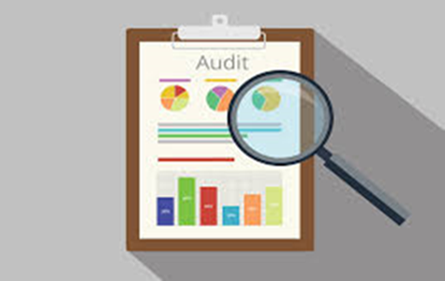
Major Audit Findings Disregard to PPRA Rules
Fraud (with or without collusion)
Poor value for money
Ineffective and inefficient solutions
Risk Assessment
Splitting of procurement to avoid tendering procedure
Procurement in piece meal
Misuse of prequalification

Slide 24
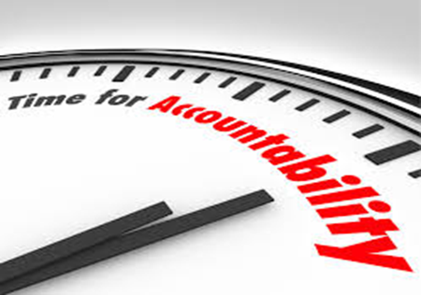
Major Audit Findings Manipulation of Exemptions
Mis-use of emergency
Deliberate delays in procurement to make use of escape clause
Bulk procurement in an event of disaster
Non-declaration of emergency
Un-due favor to one supplier
procurement is made from one supplier through
direct contracting
The specifications are so designed that one supplier benefits from it
Companies operated by close circle of management/ favoritism

Slide 25
Major Audit Findings Manipulation of Exemptions
Procurement of goods and services from firms with bad repute
Change of specification
Deliberate Procurement on non-competitive basis
Procurement without advertisement
Notice inviting tender is not clear
Vague specification
Bypass the defined specifications (type, quantity quality of items.)
Procurement in addition to the items specified
Non observance of standard procurement documents to safeguard the interest of supplier/contractor/ manufacturer

Slide 26
Common illegal and unethiocal practices in Public Procurenent
Tailoring of specifications to meet particular goods/service/works demand
Favorable terms and conditions of contract
Unbalanced contracting
Compromise on quality of deliverables
Compromise on securities and guarantees
Kick backs and commissions

Slide 27
TOR of the WGPA
There are TWO GOALS of WGPA as defined in TOR. These include developing of
An ISSAI on Public Procurement Audit for SAIs
A methodical base/framework, information exchange system and information resource

Slide 28
Goal ONE Developing an ISSAI on Procurement Audit
Its recommended that while developing an ISSAI on Procurement Audit as per the first goal of the WGPA, the variation in the procurement rules and procedures adopted by various SAIs may also be considered

Slide 29
Goal ONE Suggestions
It is suggested that the ISSAI developed should comprise of two parts.
Part I should relate to the auditing of general and common principles of procurement adopted by all SAIs in common to ensure competitive bidding and transparency.
Part II should address the difference in the public procurement systems adopted by different SAIs and variations in their applicable rules and procedures

Slide 30
Goal ONE Suggestions (Departure from Standard)
It’s also suggested that the Standard should also address the special conditions in which departure is allowed from the standard rules and procedures.
As in case of emergency the Public Procurement Regulatory Authority ( PPRA ) rules adopted in Pakistan allows public procurement without competitive bidding if the procurement is to be made in an emergency like flood famine or earthquake.

Slide 31
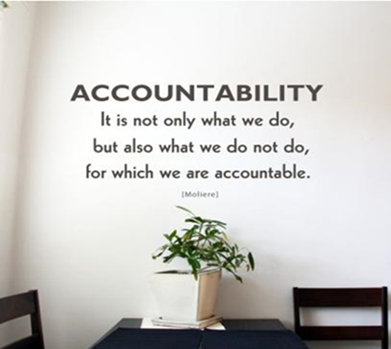
Goal Two Develop a framework, information exchange system
Goal two is to develop a
Methodical base/Framework
Information Exchange System
Information resource
for SAIs on Procurement Audit

Slide 32
Goal Two Suggestions
In this regard it is suggested that three separate data banks and guidelines be developed for auditing of
Public procurement of goods
Public procurement of Services and
Public procurement of Works
It’s also suggested that WGPA should also benefit from the Guidelines and manuals developed by International Agencies and various organs of United Nations like UNIDO.

Slide 33
Goal Two Suggestions
WGPA may include in its ToR,
The recommendation for improving the procurement policies and procedures, identified during the process of developing an auditing standard and a methodical base/framework

